Slide 1
Pi and Wyliodrin
Set up
Slides prepared by: fxwalsh

Slide 2
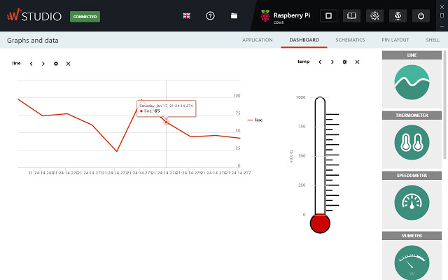
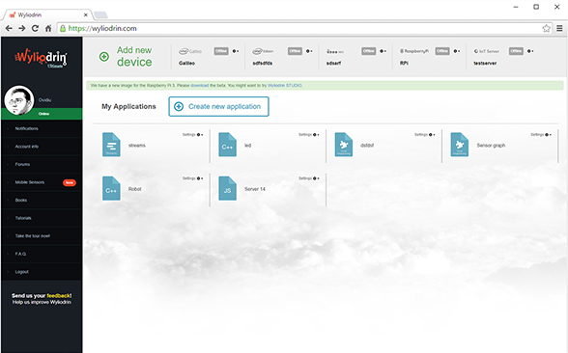
Approaches
You’ve 2 options for using a raspberry pi with Wyliodrin
Use Wyiodrin Studio
Chrome Plugin
Can work offline
Use Wyliodin online IDE
Online service
Need to create account and Log in.
Both can be used for the same device:
Can jump between the two
Might need to import/export projects though

Slide 3
Wyliodrin Studio
Chrome Plugin
Local version of Wyliodrin IDE
Runs offline
Connect directly to device
Can configure wifi connection on Pi
To get started go to:
https://www.wyliodrin.com/wyliodrin-studio/

Slide 4
Wyliodrin IDE
Web-based platform for programming devices
Requires internet connection
Requires you device connected to the internet
Advantage
Can maintain connection to multiple devices
To get started…
https://www.wyliodrin.com/get-started/

